Slide 1
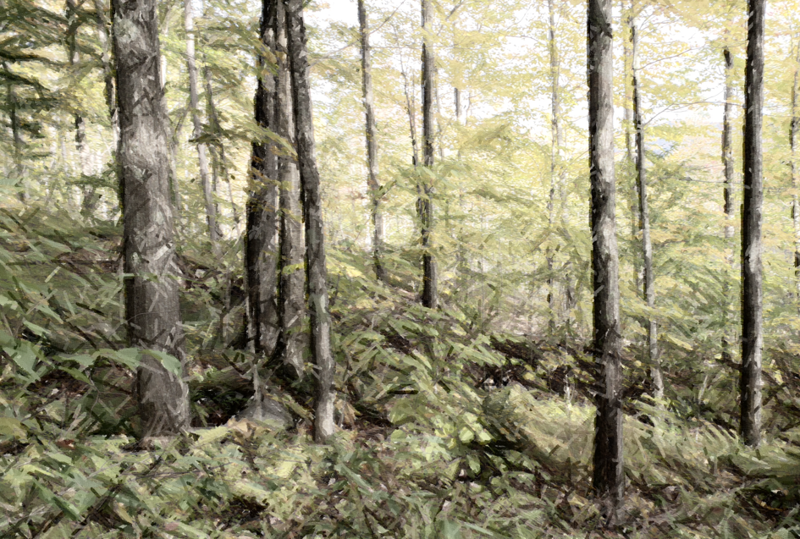




Northeastern seedling response to future precipitation scenarios:
implications for adaptive management
2019 Forest Ecosystem Monitoring Cooperative Conference
Monitoring For Impacts Of Climate Change:
Tracking and measuring outcomes in northeastern forests
Burlington, VT
December 13, 2019
Pete Clark and Tony D’Amato
Rubenstein School for Environment and Natural Resources
University of Vermont

Slide 2
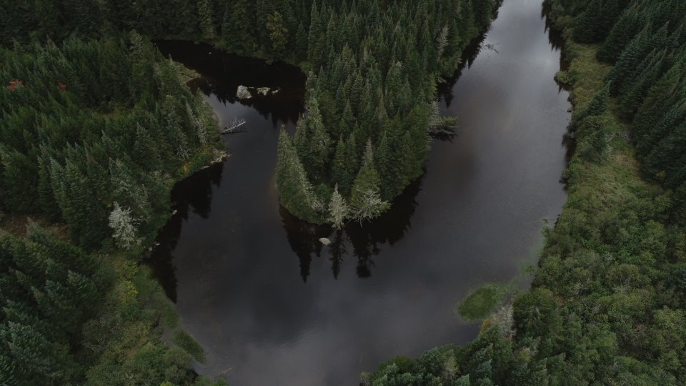
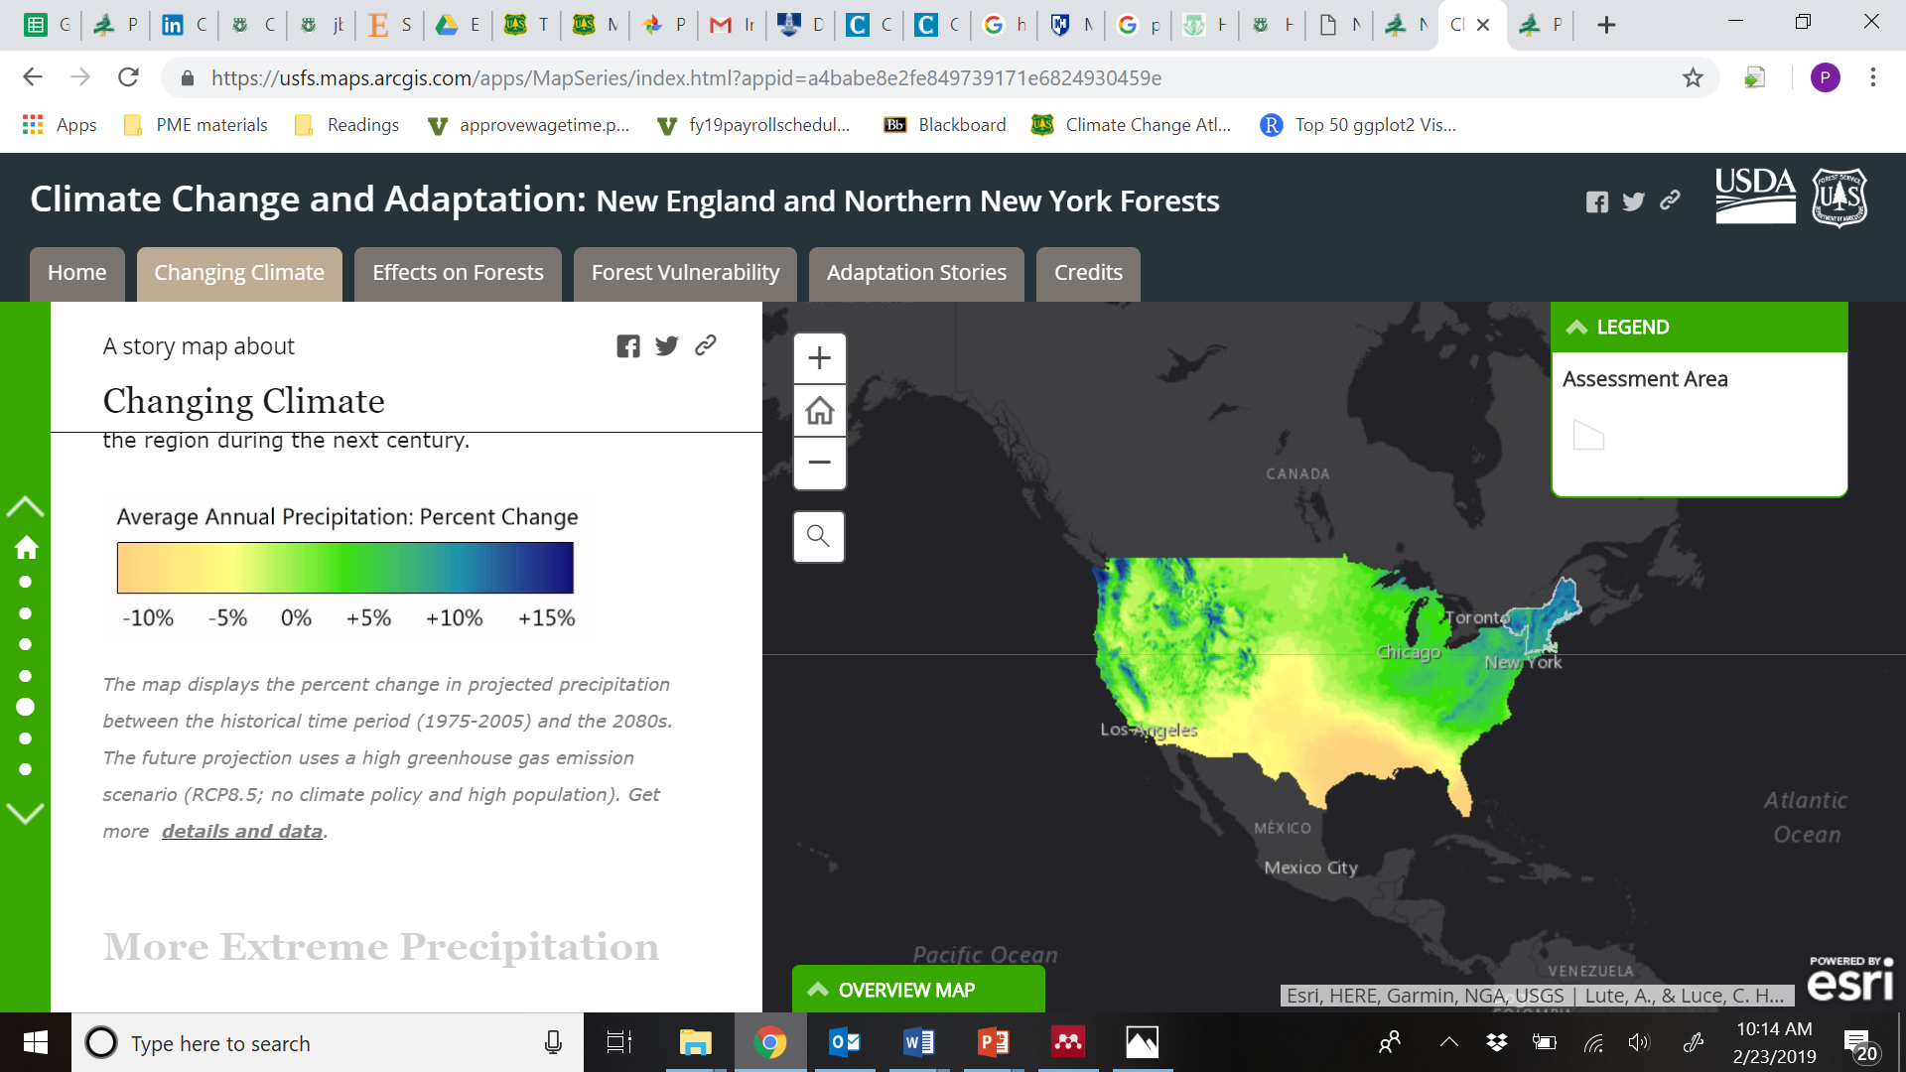
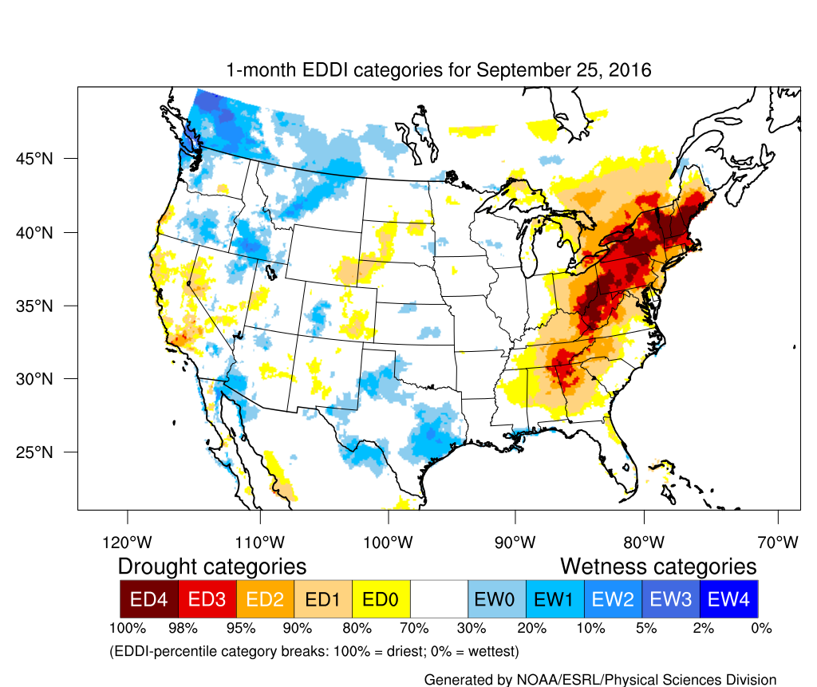
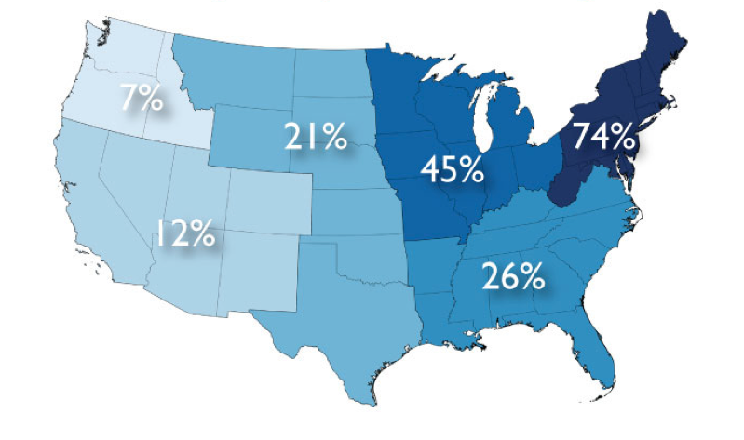
Increase in annual rainfall in the Northeastern US
NIACS 2019
Increasing drought frequency
Increasing heavy, episodic downpours
(Sept 2016)
Image: Ali Hall
NOAA
NOAA 2018
Notes:
So, to kick things off, many of our models suggest that the northeast may be getting wetter under climate change, but here a rising tide doesn’t raise all ships and we don’t expect to see an even increase across the year, rather the timing, duration, and seasonality may be shifting
Drier growing seasons punctuated by more frequent drought events
Punctuated by increasing heavy, episodic downpours.
So this annual increase may be accounted for with heavy rainfall despite some of these longer drier periods

Slide 3
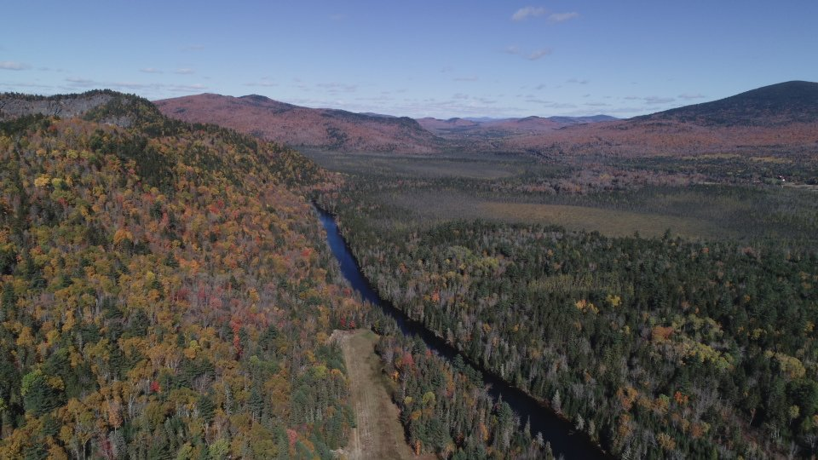
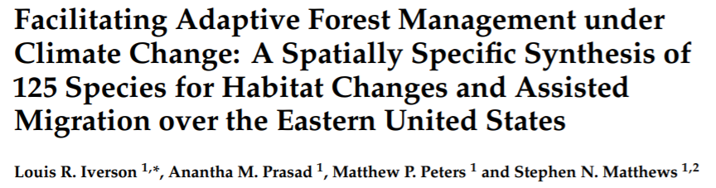
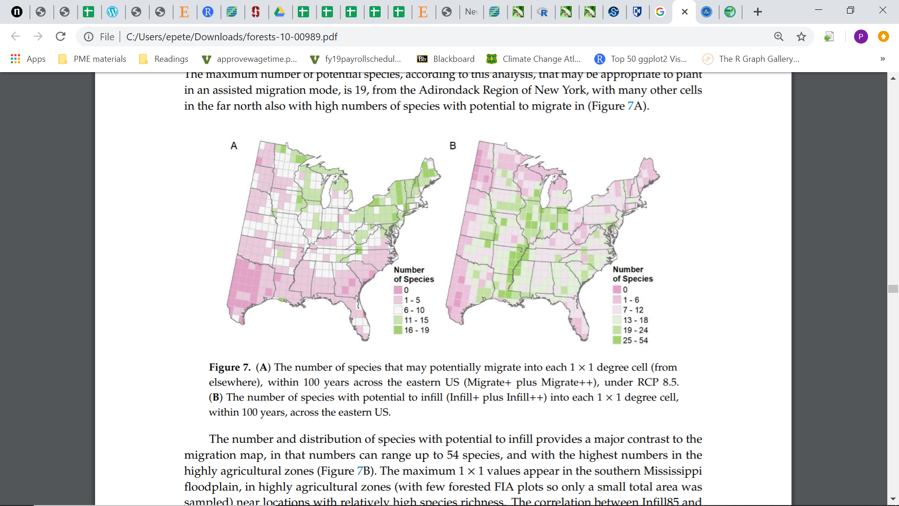
Image: Ali Hall
Iverson et al. 2019
Notes:
With a changing climate, we also know from models like Climate Change Tree Atlas that potential species habitat and ranges may shift. More recently, the same authors of ATLAS published this paper use a similar climate envelope approach to inform adaptive forest management and assisted migration, suggesting that the northeastern US is also a potential hotbed or migratory front for new species habitat
Facilitating Adaptive Forest Management under Climate Change: A Spatially Specific Synthesis of 125 Species for Habitat Changes and Assisted Migration over the Eastern United States
Forests 10, 989; doi:10.3390/f10110989

Slide 4
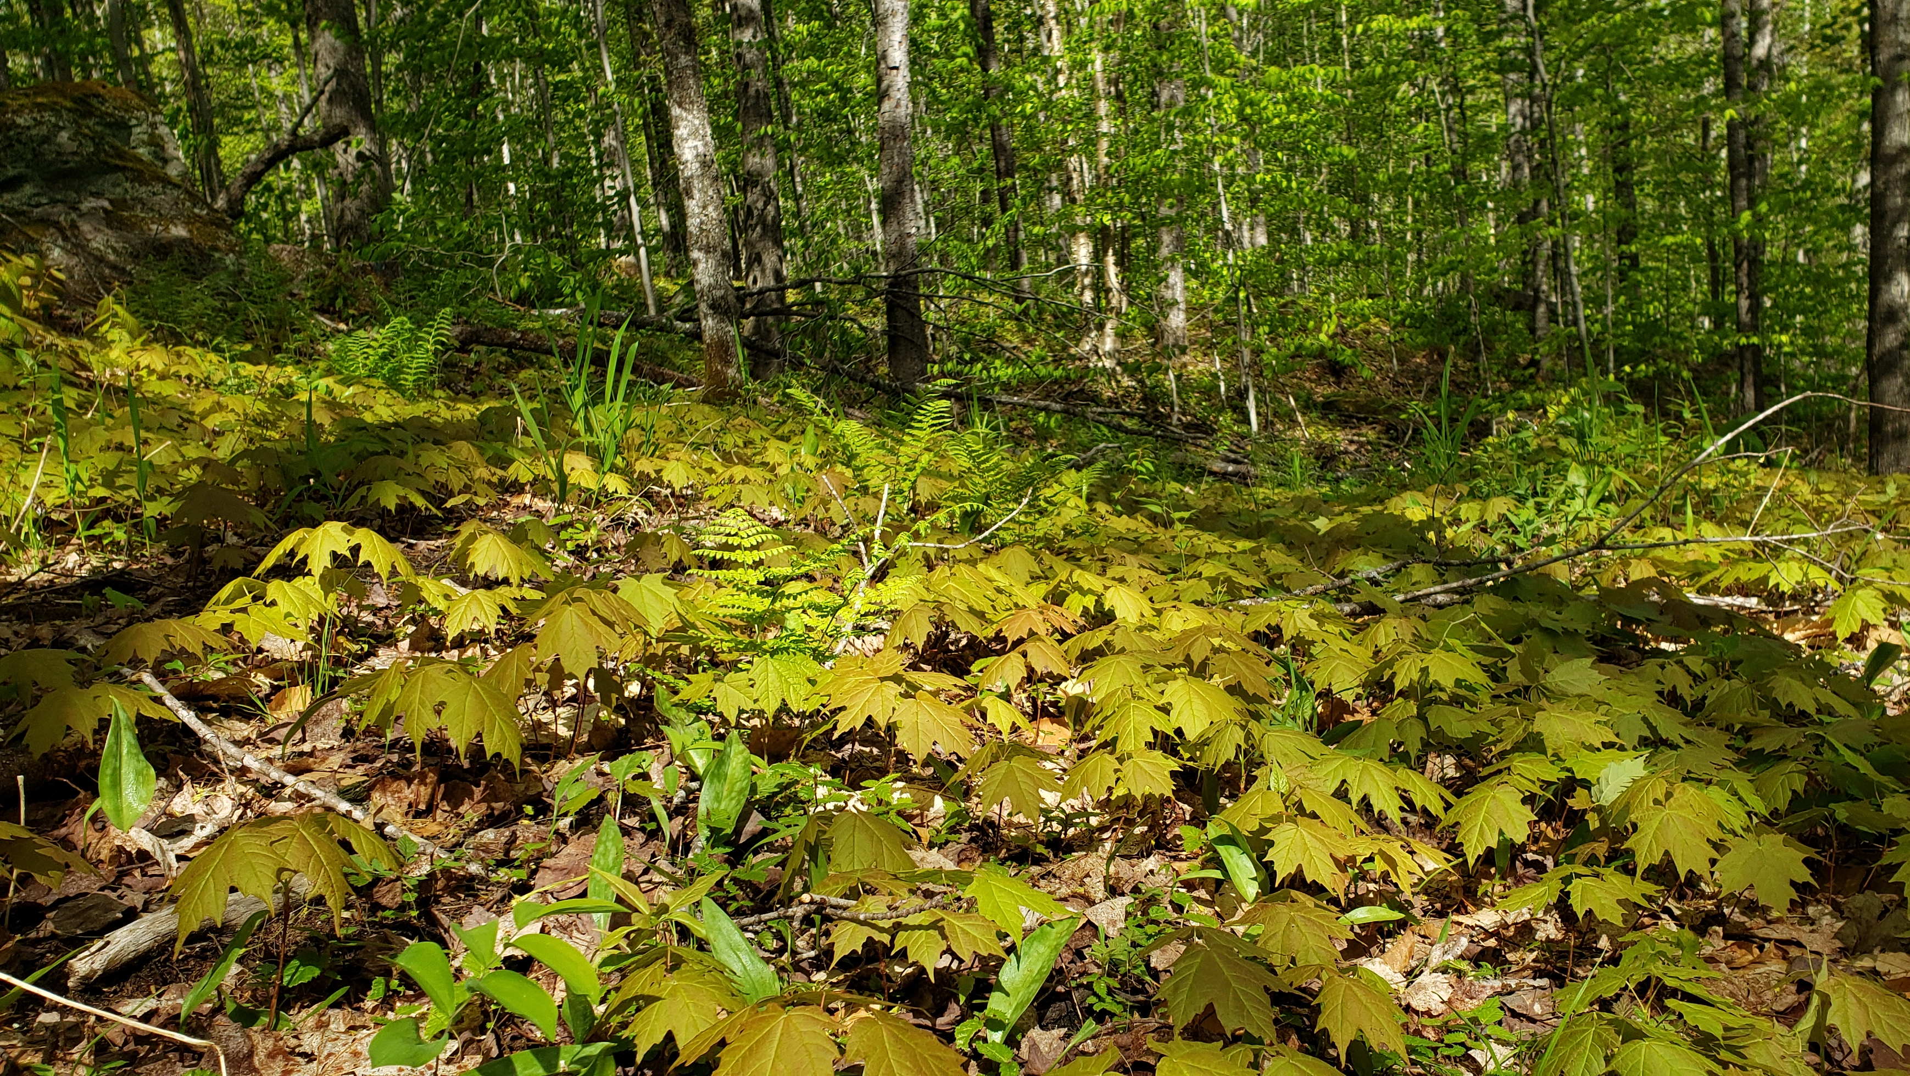
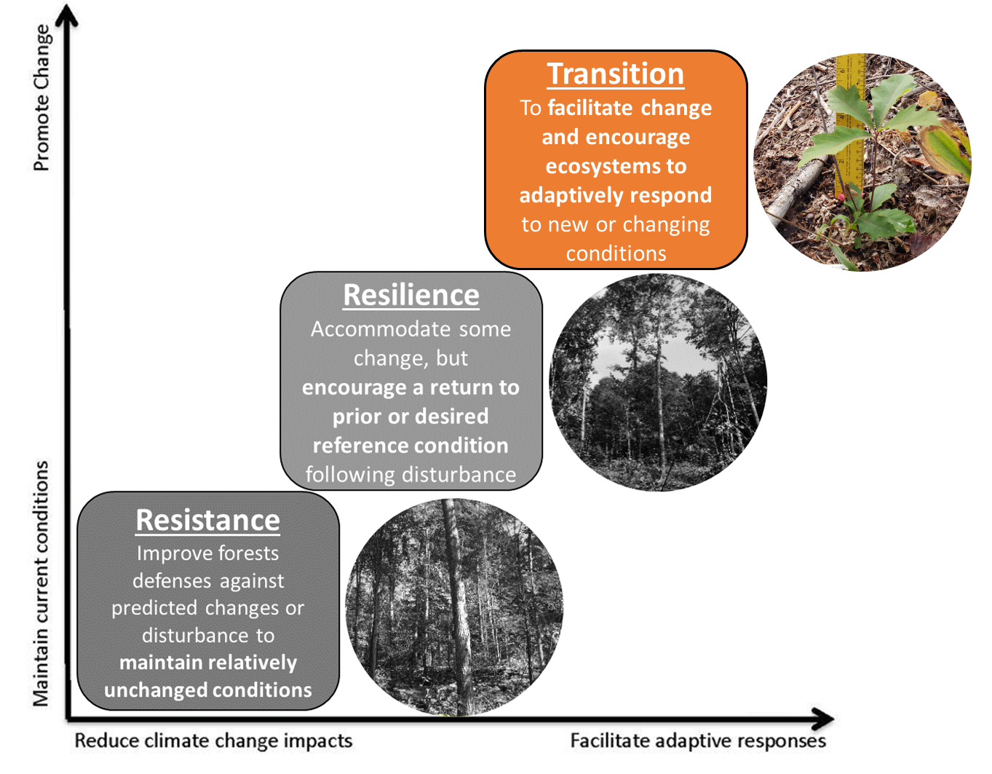
How might future precipitation scenarios influence or filter the regeneration bottleneck in northeastern forests?
What are the implications of these results to adaptive management and associated climate suitable plantings?
Recreated from Nagel et al. 2017
Notes:
So with these projected changes, make scientists and managers have asked how forests in this region will respond.
While most of this research has examined the response of mature forests and whole ecosystems, considerably less attention has been paid to the regeneration layer, a critical bottleneck in the establishment of future forests.
With this research we ask – Q1
Moreover – Q2
The later is particularly important for managers seeking adaptive management options during a time of uncertainty

Slide 5
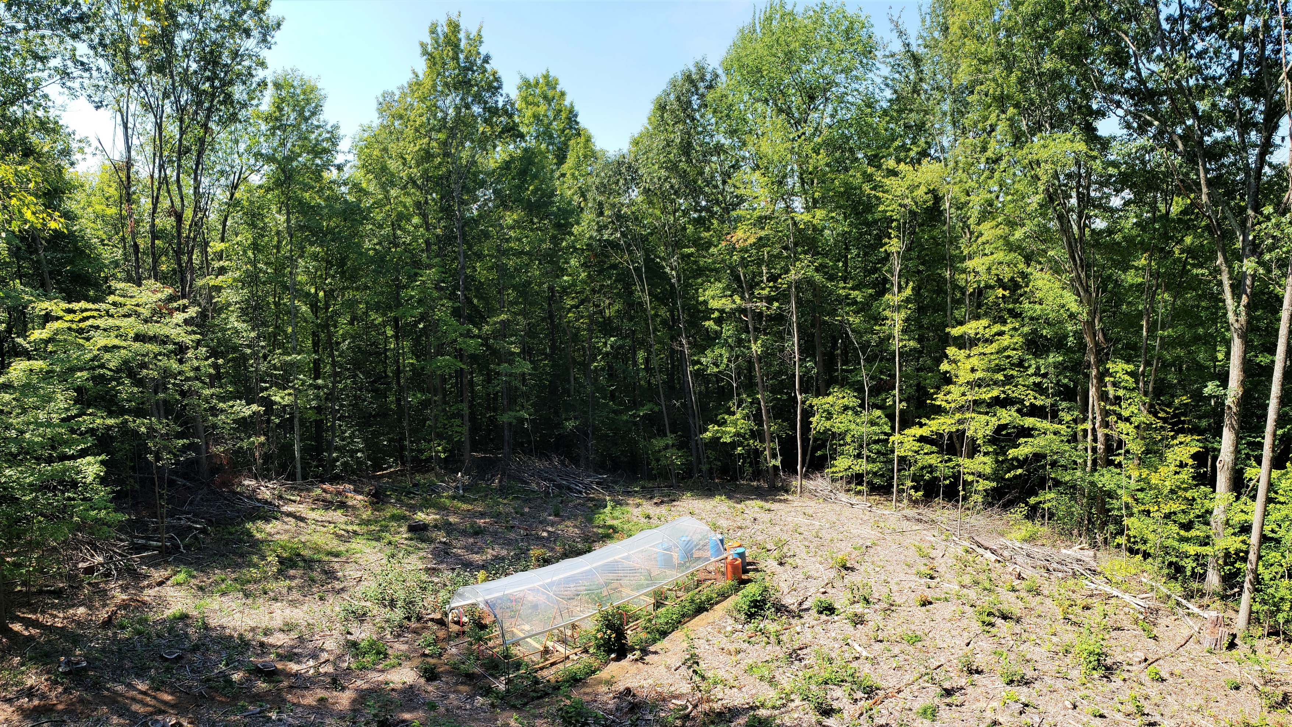
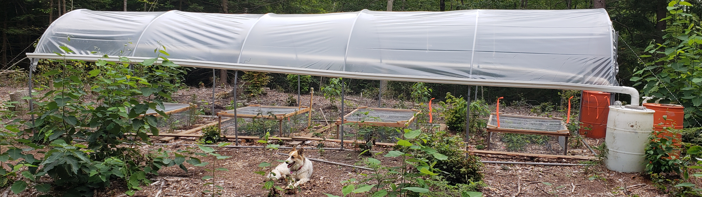

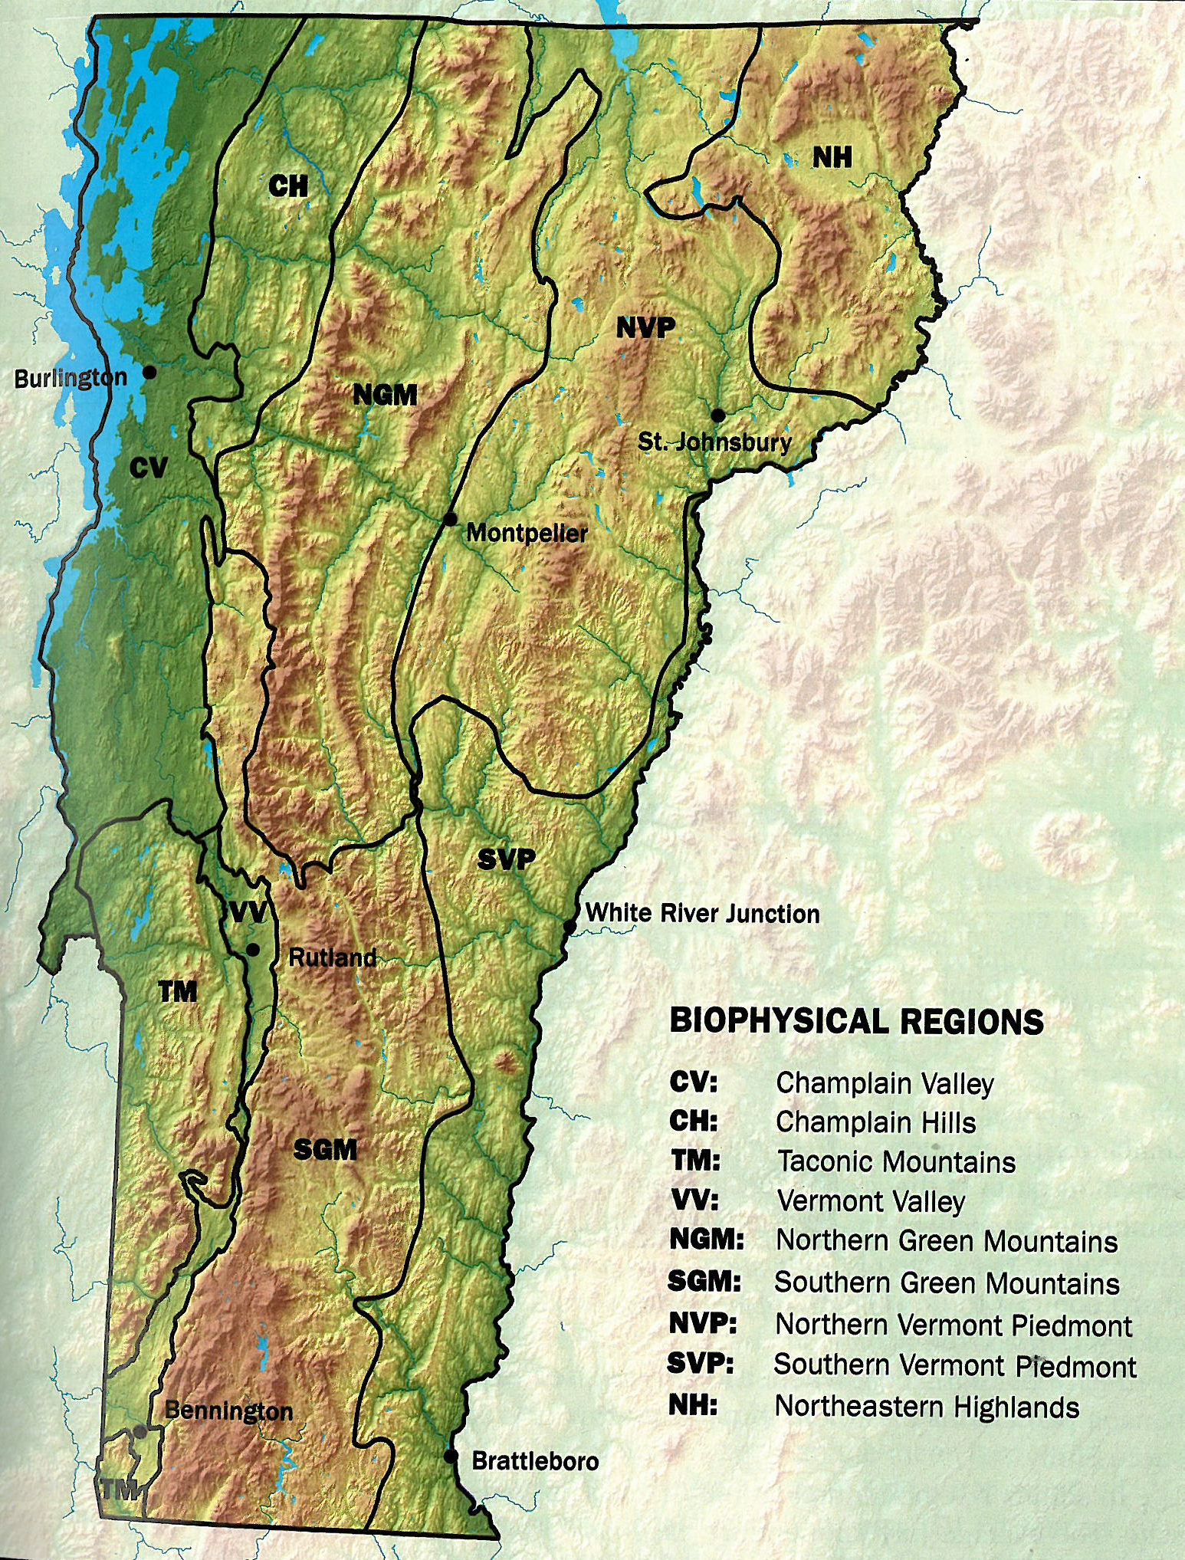
Species | Future Habitat
American beech
American chestnut
Basswood | /
Bigtooth aspen
Bitternut hickory
Black birch
Black cherry
Eastern hemlock
Red maple
Red oak
Red spruce
Sugar maple
White pine
Yellow birch | /
Thompson et al. 2019
Increase
No change
Decrease
Notes:
The work I am presenting on today is a replicated precipitation manipulation experiment located in situ in ¼ acre harvest openings representative of gap scale dynamics or small-patch cuts typical in the Northeast.
The research is located in the university of VT’s Jericho Research Forest in the newly described Champlain Hills biophysical region, comprised of classic northern hardwoods but also strong oak-pine hemlock component.
The soils are these sites are sandy glaciofluvial deposits, or loamy sands and classified as somewhat excessively drained – making it a good candidate site for such a study.
SLIDE- The experiment allows for a 100% exclosure and collection of ambient rainfall allowing for the redistribution across four treatment areas.
SLIDE- We investigated 14 species across a suite of functional traits and included various life stages from sown seed to planted bare root stock
SLIDE -

Slide 6
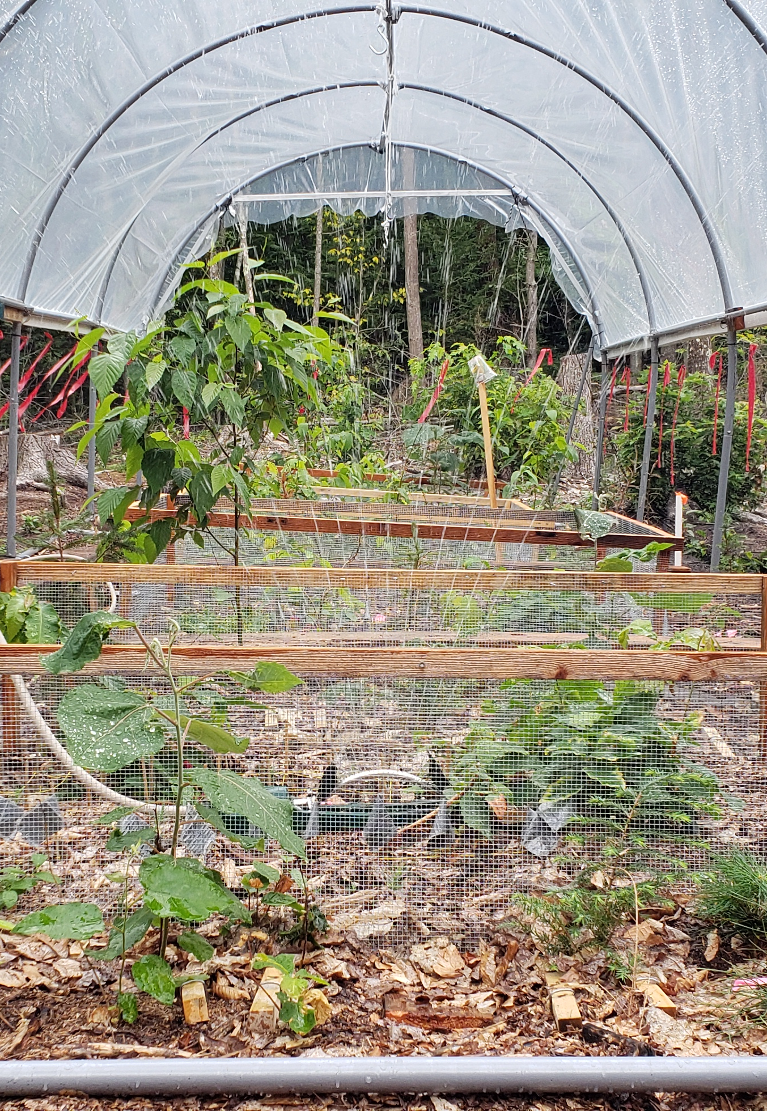
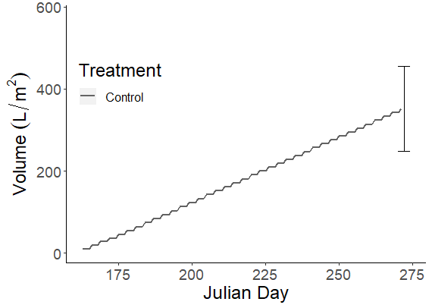
Control: “Expected” daily precip. (100 yr. met. record)
1 σ
June
Sept
Notes:
We developed several precipitation scenarios based off various models using a 100 year daily meteorological record from the study area
This figure shows growing season rainfall depicting volume/m2 and frequency in days of rain events, culminating in overall accumulation over the growing season
As a baseline we start with our Control which is I would call “typical” precipitation volume and frequency, if there is such a thing in the Northeast – and not the bar showing 1std in growing season accumulation

Slide 7
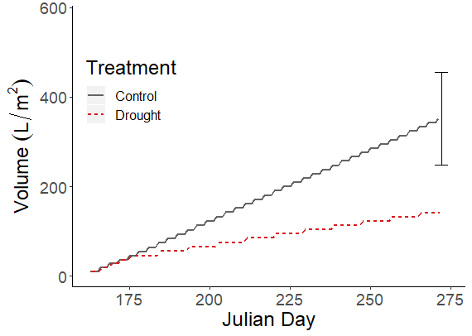
Control: “Expected” daily precip. (100 yr. met. record)
Drought: Extreme 95th percentile drought
1 σ
June
Sept
Notes:
Next, we add a second treatment representative of a 95th, so a drought we might only see a few times a century
Characterized by long stretches of no rain with modest rain events – well outside of the natural range of variability

Slide 8
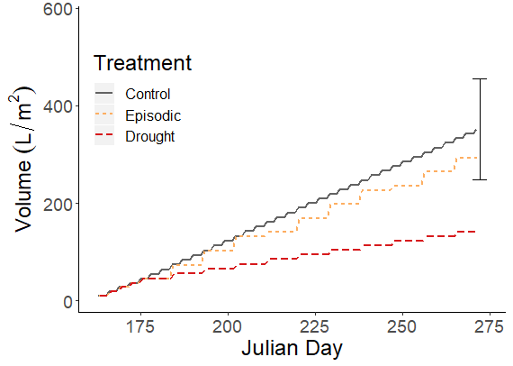
Control: “Expected” daily precip. (100 yr. met. record)
Drought: Extreme 95th percentile drought
Episodic: Infrequent, high intensity rain events (RCP8.5)
1 σ
June
Sept
Notes:
Third, we developed a treatment we are calling Episodic that incorporates high intensity rain events, something like 2 or 3 inches of rain coupled with long stretches of rainless days like the drought treatment. Note that total accumulation is well within 1 std

Slide 9
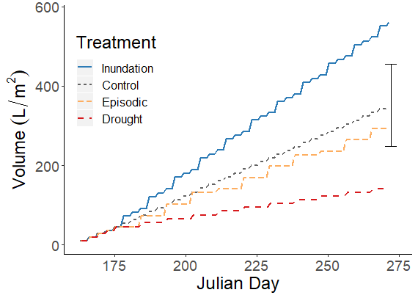
Control: “Expected” daily precip. (100 yr. met. record)
Drought: Extreme 95th percentile drought
Episodic: Infrequent, high intensity rain events (RCP8.5)
Inundation: Frequent, high intensity events
1 σ
June
Sept
Notes:
A lastly a inundation treatment with regular, frequent intense rainfall., well outside of the norm.

Slide 10
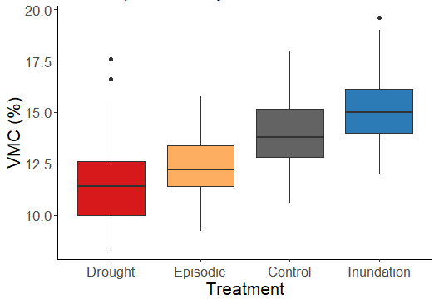
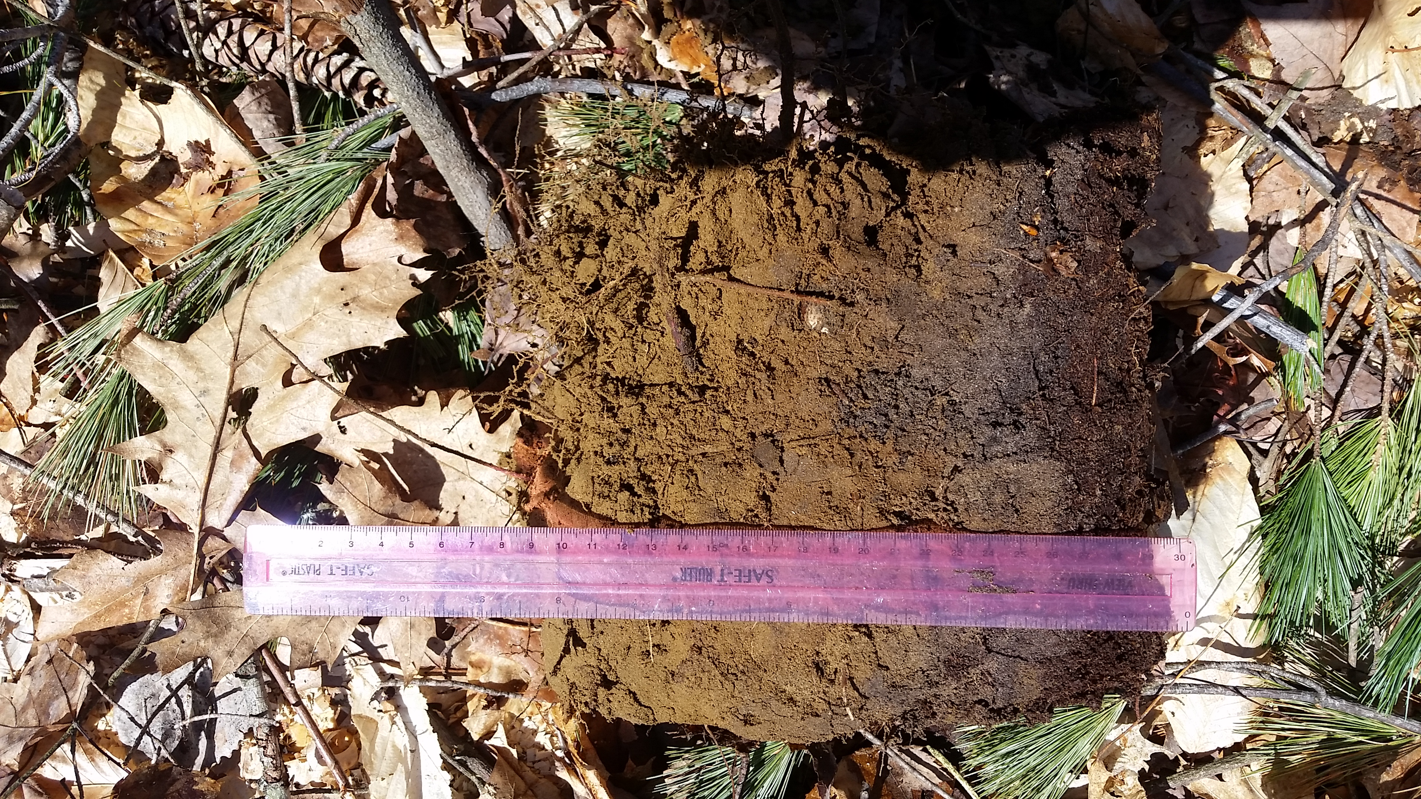
Effect of treatment on soil moisture field capacity
20cm depth three days after “rain event”
All groups significantly different at p < 0.01
Notes:
Using a TDR we measured soil moisture before and after each treatment at 20cm.
Despite these soils being excessively well drained, results shown here show a significant difference in VMC across precipitation treatment

Slide 11
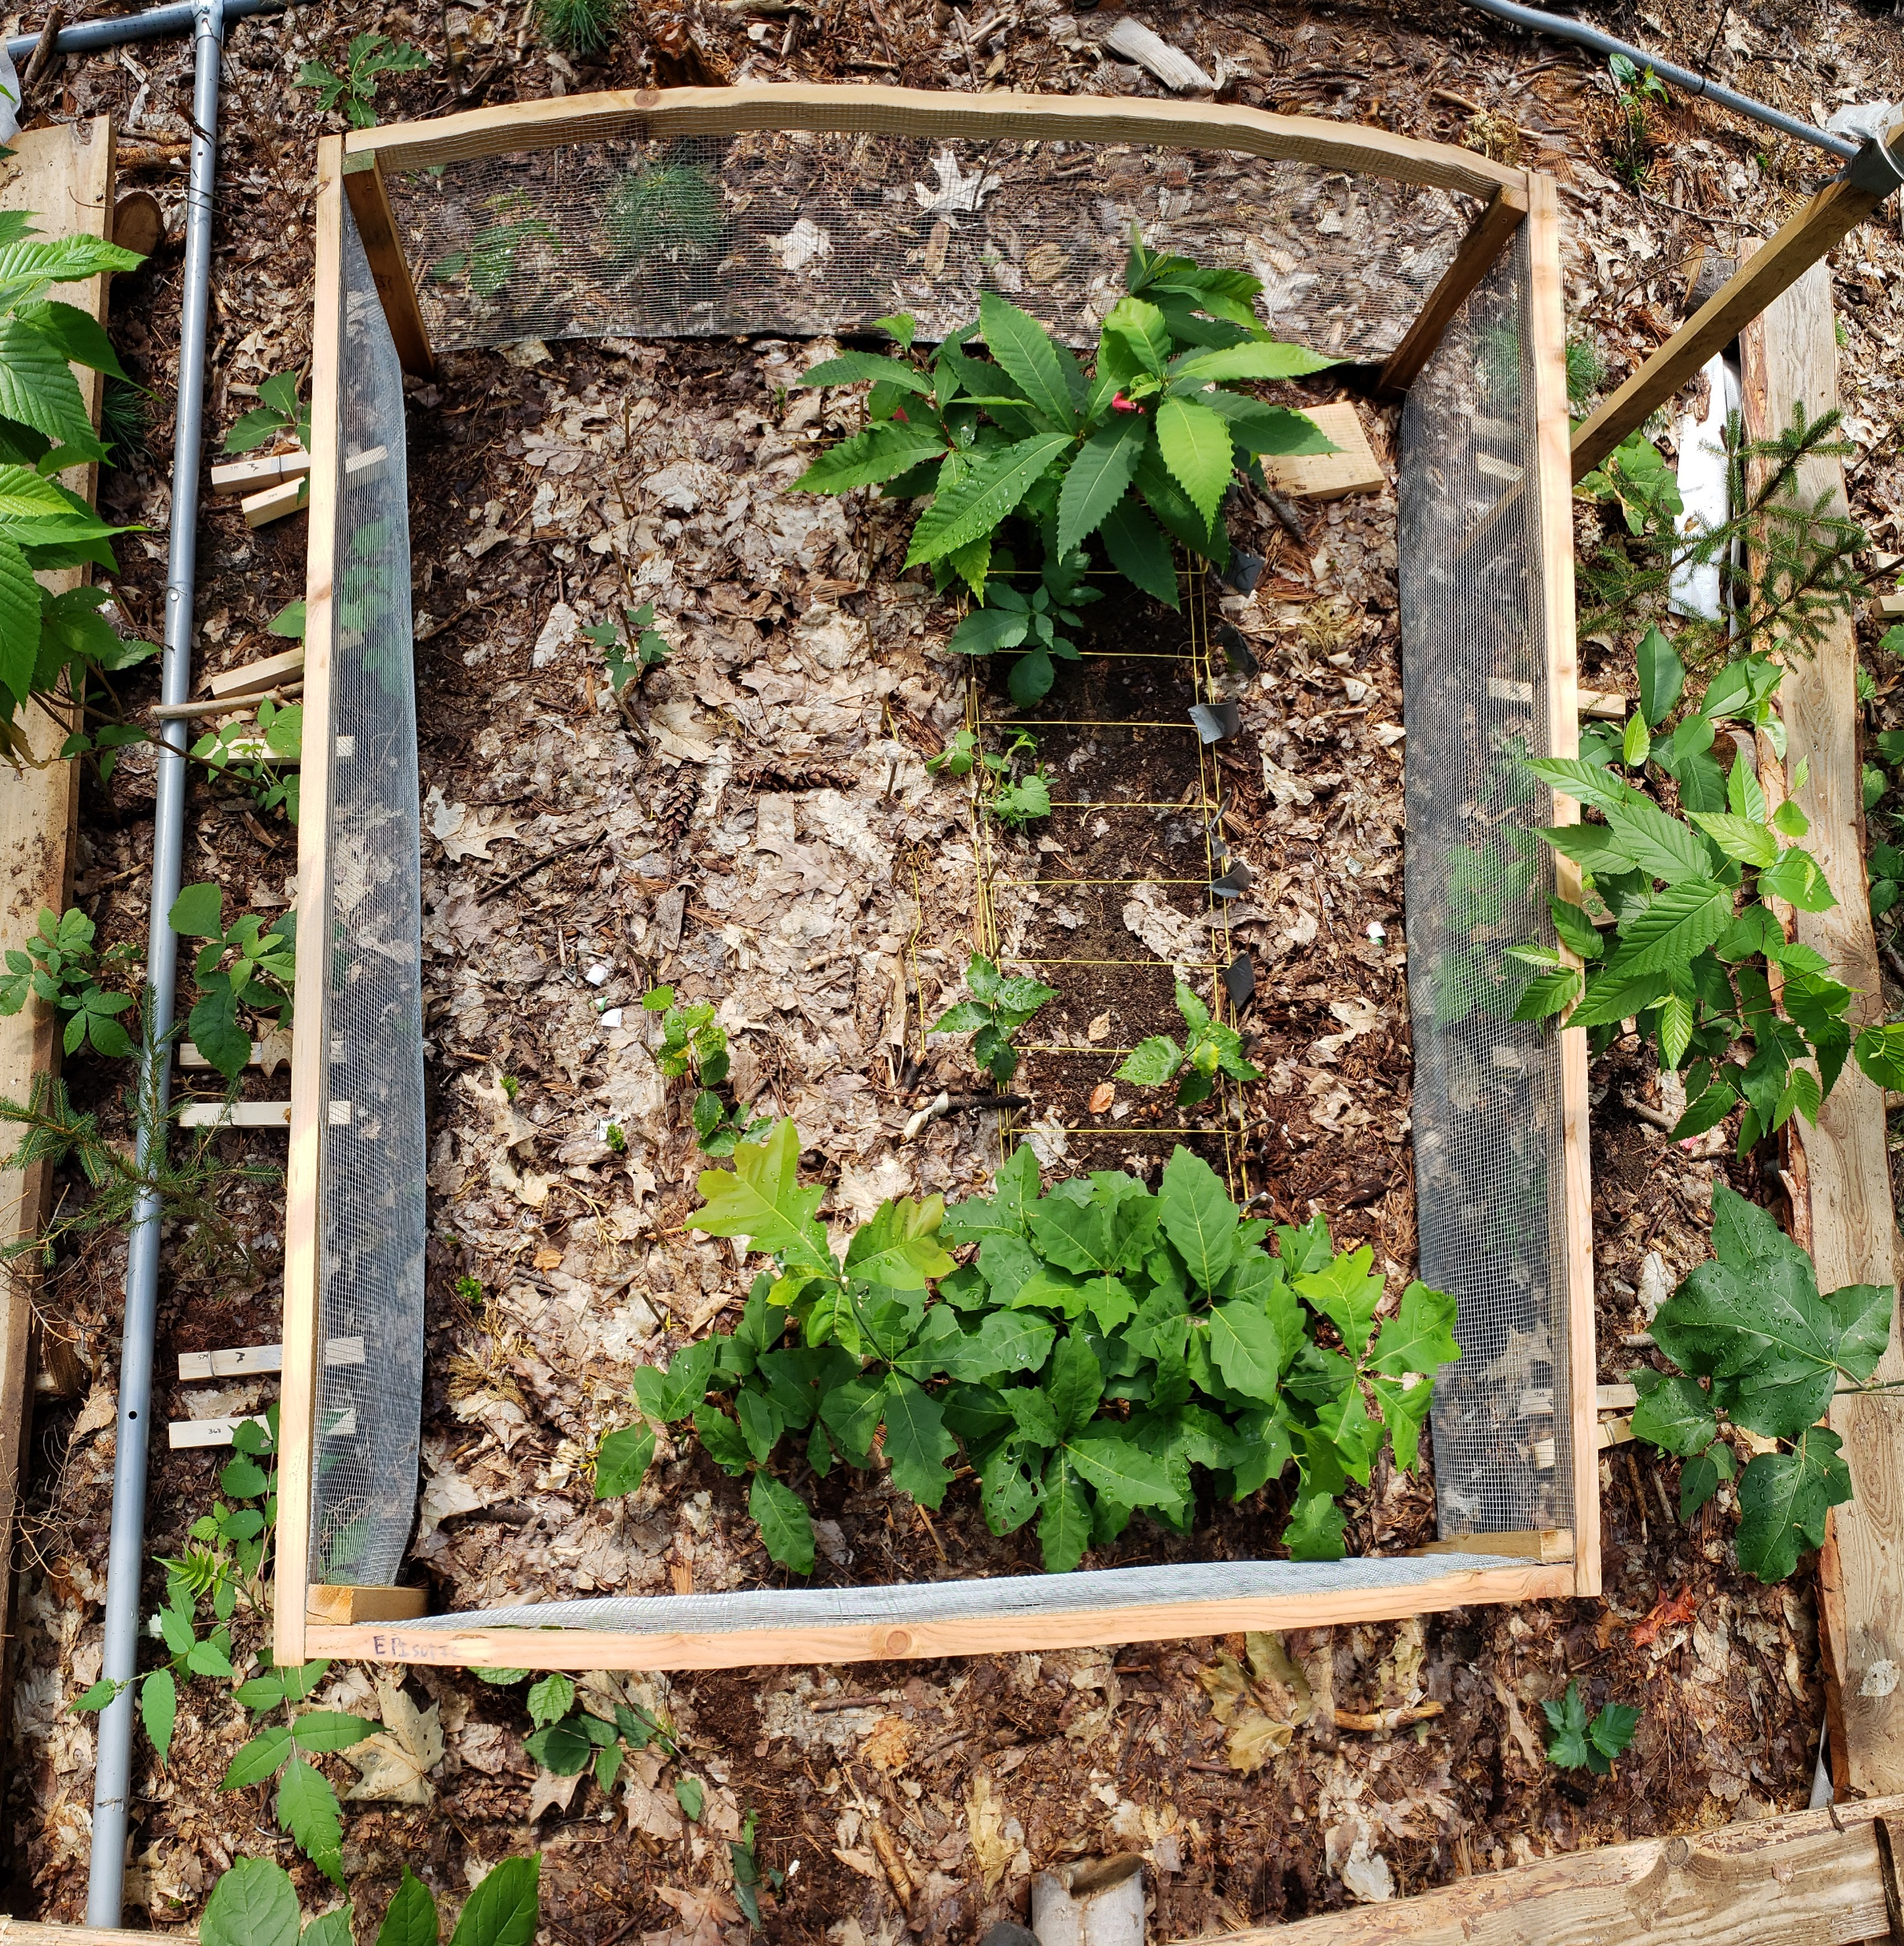
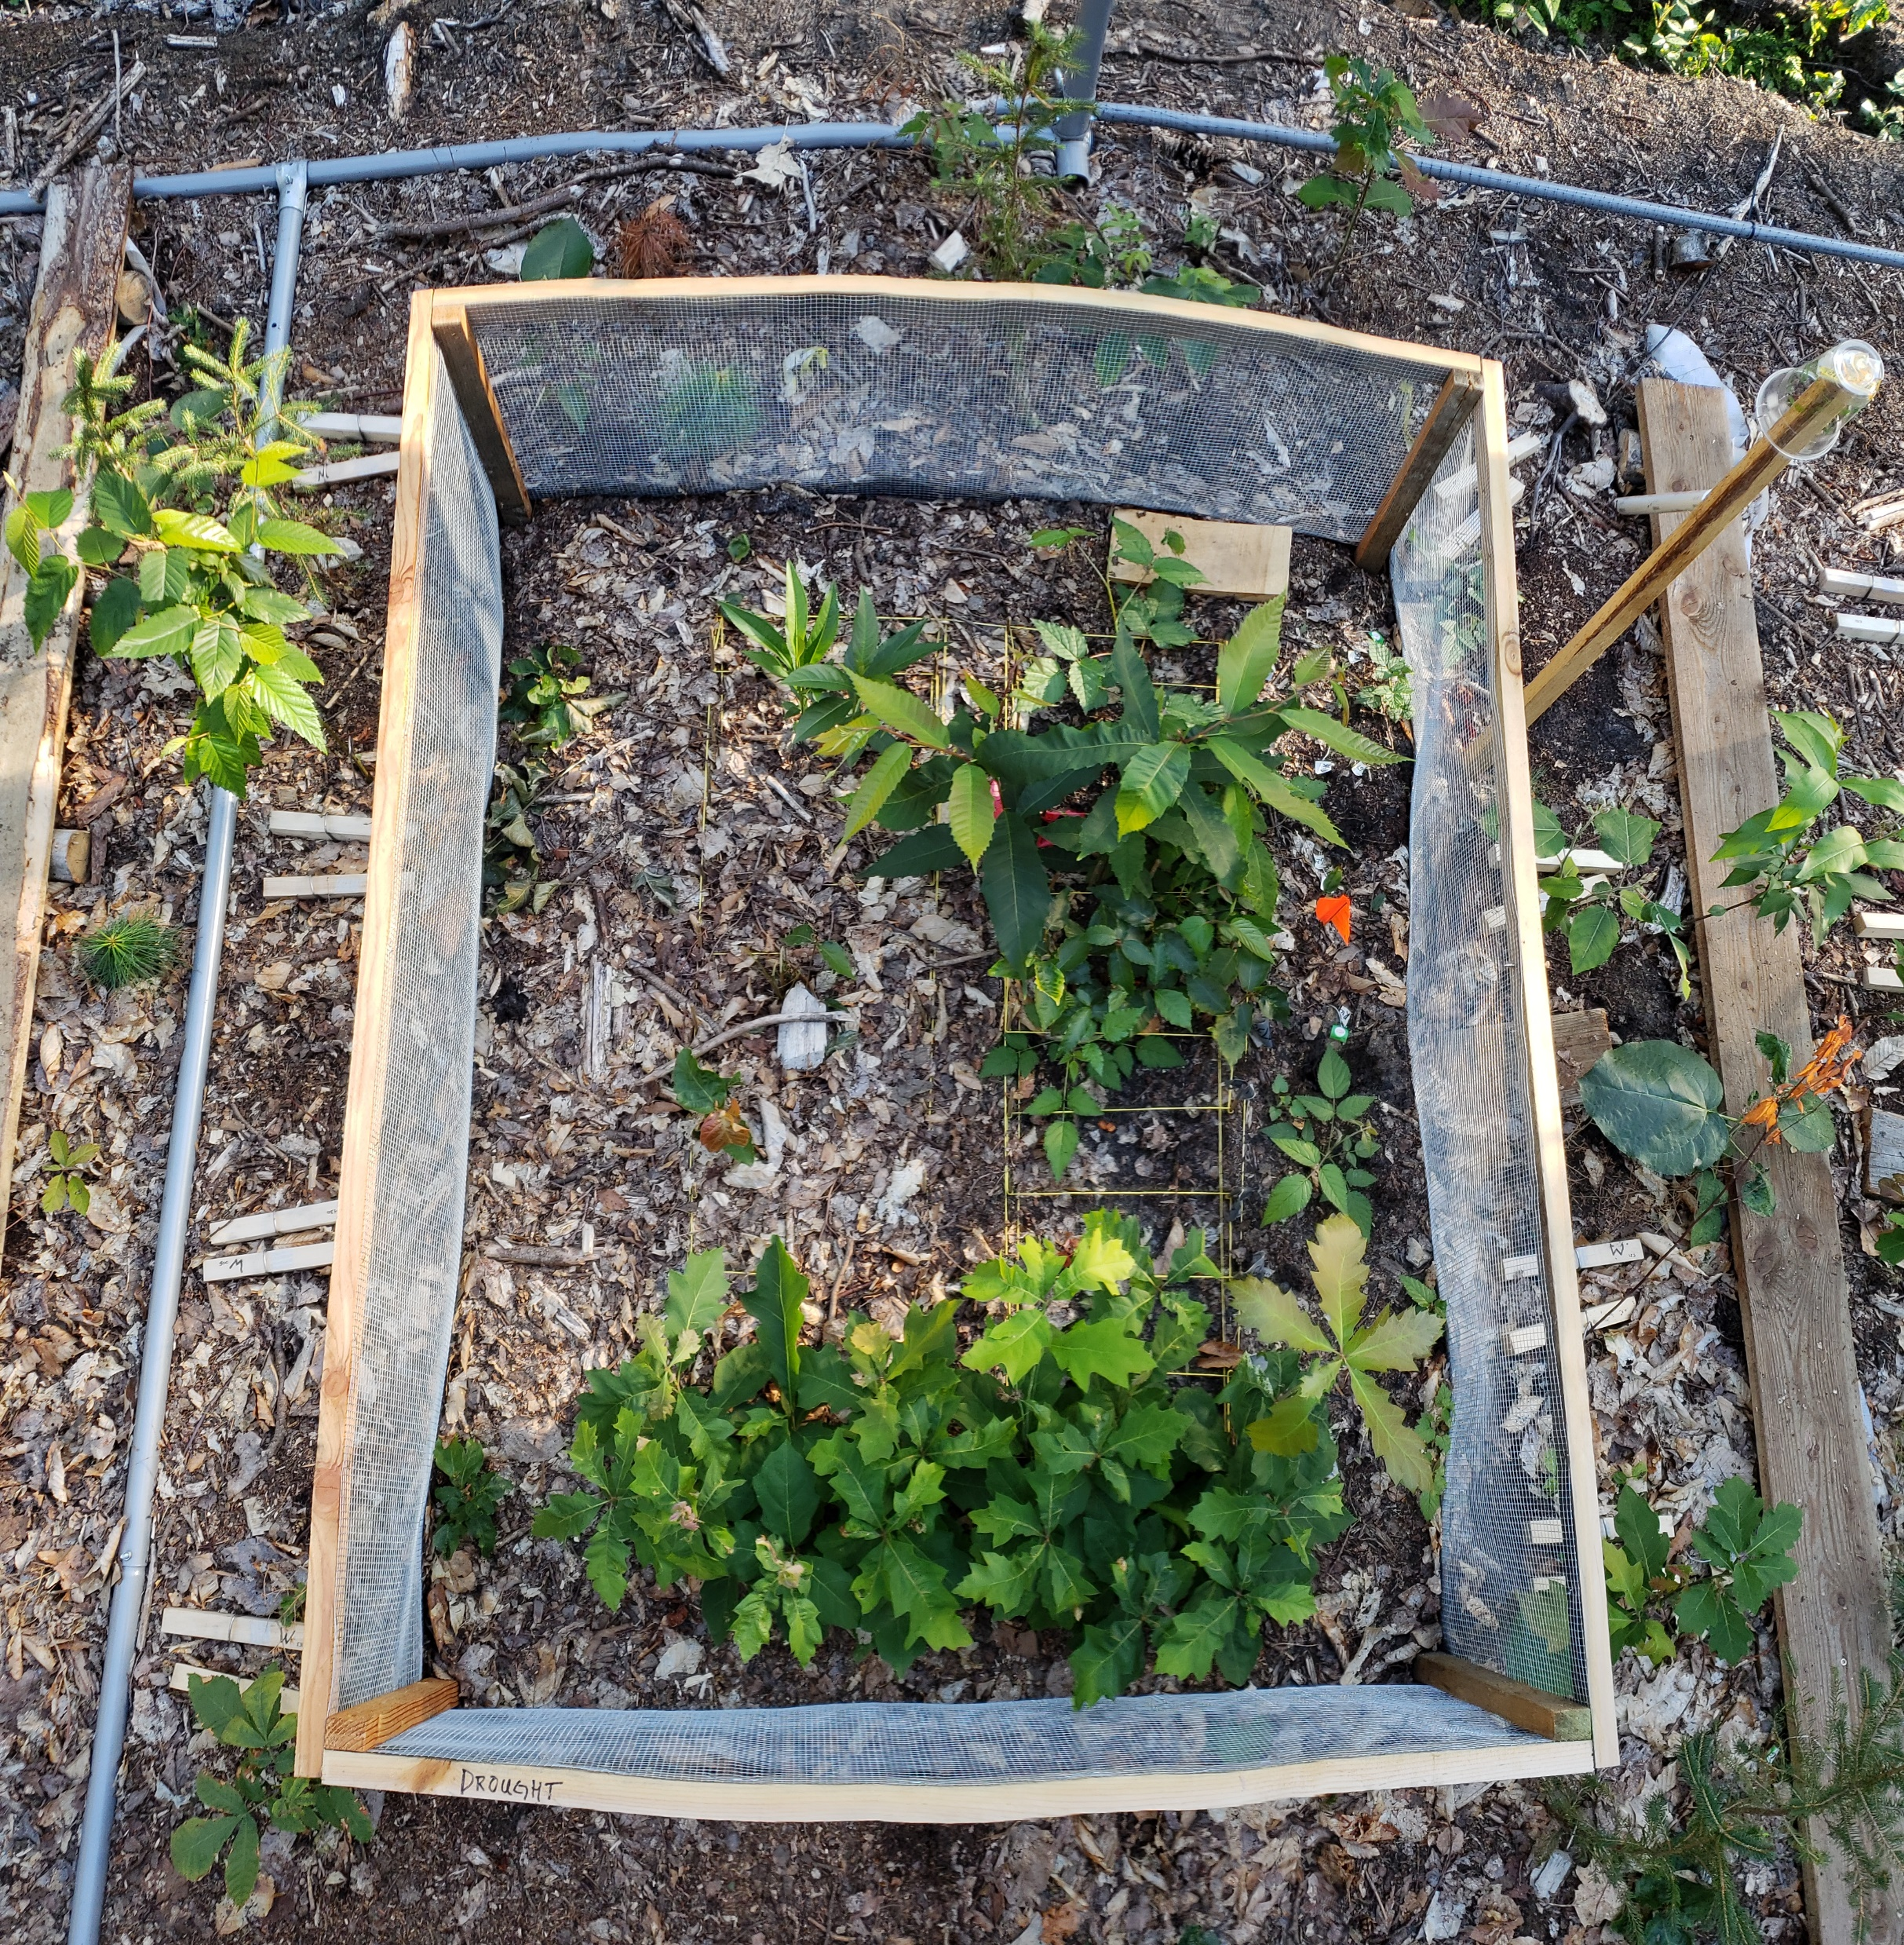
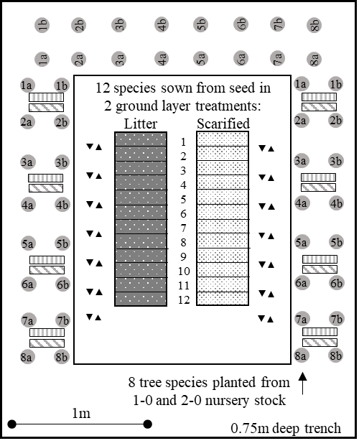
Notes:
Our study design includes a central planting area with 12 species sown from seed where each was sown in 2 ground substrate treatments:
an unmodified litter layer representative of a majority of undisturbed forest floors and rooting space for the natural seedbank
as well as and a scarified, exposed mineral soil bed representative of the disturbance caused by a tip up or harvesting operation.
Outside of this caged area we planted 1 and 2 year of Nursery grown seedlings from 8 “future adapted” species targeted for assisted migration
Bi-weekly germination rates and survival were collected over a 107-day season and examined total seasonal aboveground allocation (e.g., height, root collar diameter, shoot extension, nodes and leaf parts) and phenological measurements were recorded to examine the physiological response to water limitation

Slide 12
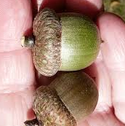
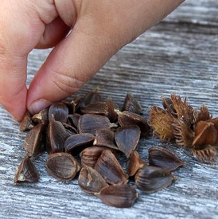
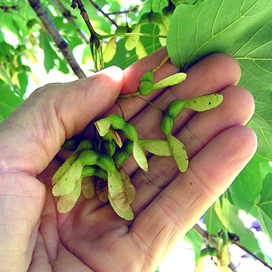
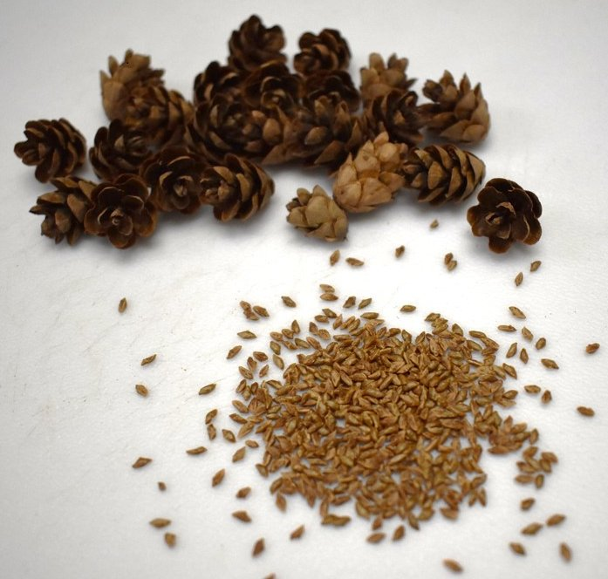
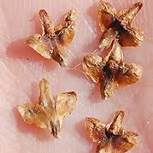
First Year Survival direct seeded species in scarified soils
Seed Mass
Response generally follow expected trends but:
  Species can be grouped as INSENSITIVE or SENSITIVE
  Interspecies response likely driven by functional traits
  Two response to WET and DRY precipitation scenarios
How much do traits like seed mass matter?
Notes:
So what we are looking at here is first year survival for 8 species, direct seeded in the scarified soils
Describe figure, treatments and colors
How they can be grouped – Seed mass, but also FAD, Nhardwoods, Conifers, birch

Slide 13
Functional Traits Matter the interacting effect of seed mass and precipitation
Survival Response by Seed Mass and Grouped Precipitation Treatment
Model using grouped treatments
  WET: Control & Inundation
  DRY: Episodic & Drought
Separation then convergence in trend lines
Seed mass plays important role, particularly under dry precipitation scenarios
Survival ~ Treatment * Seed Mass
Adj r² = 0.72 p < 0.000

Slide 14
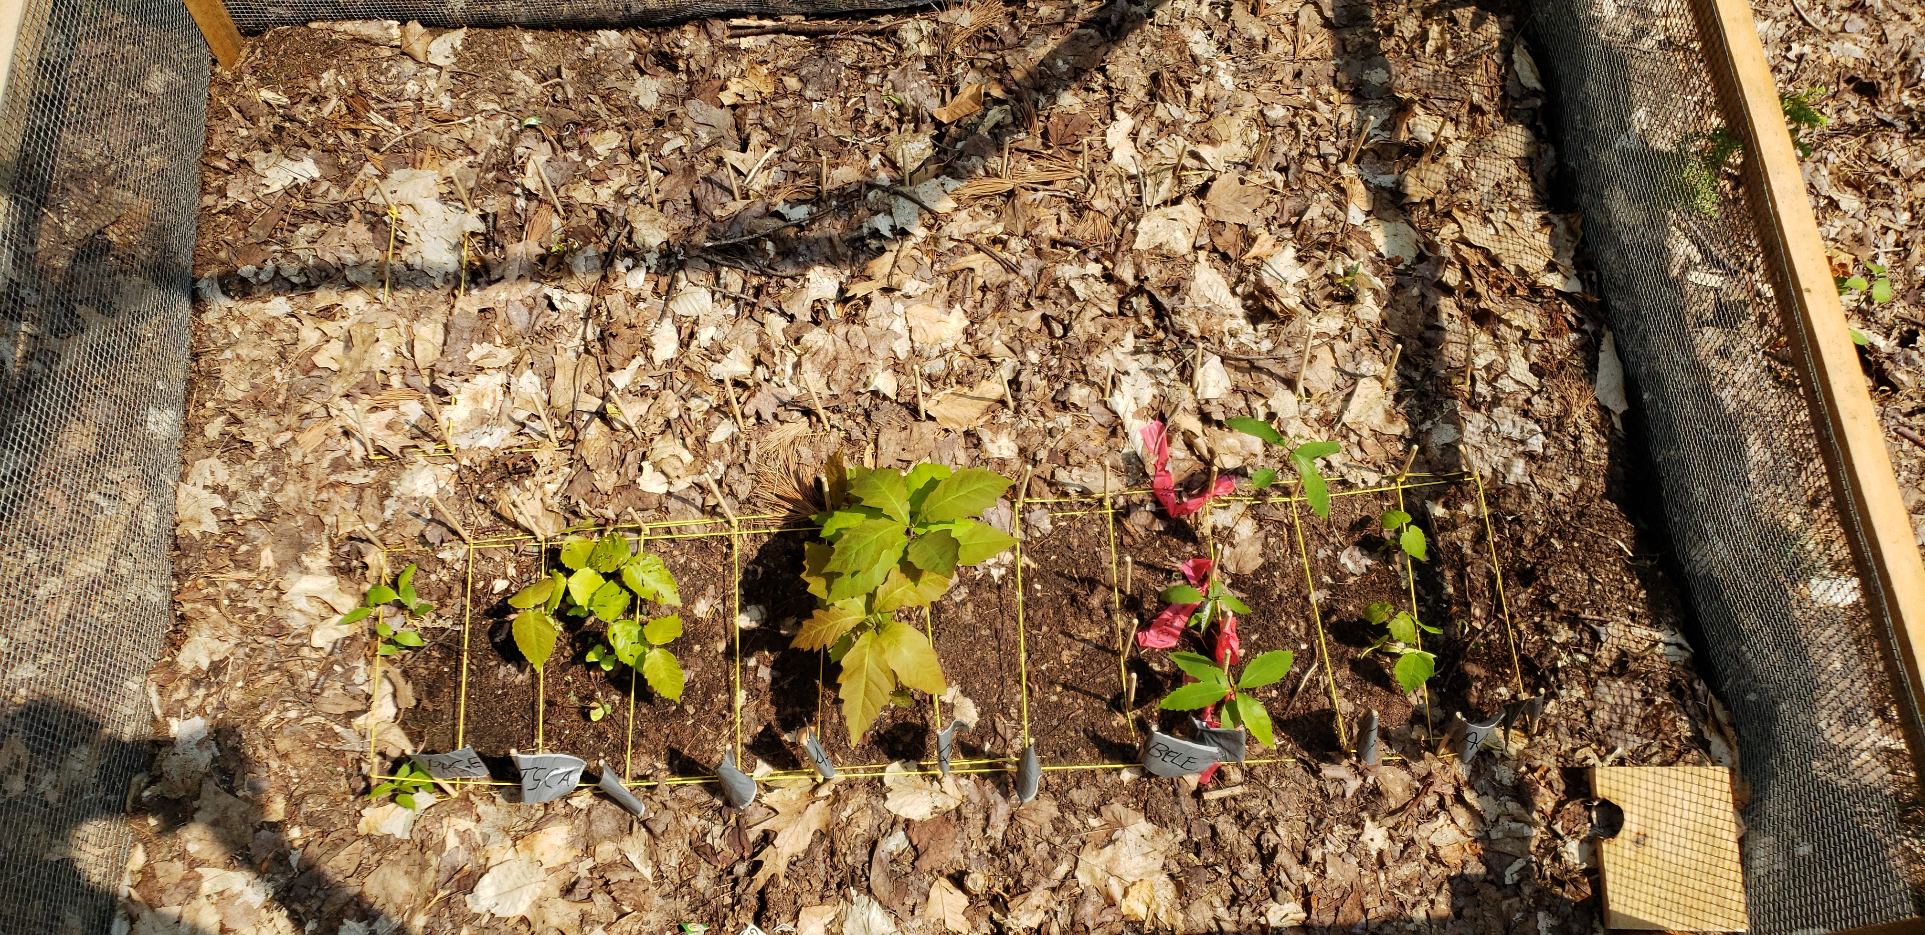
Growing Substrate the role of site on germination and survival
Survival Response by Growing Substrate
Unmodified
Scarified
Substrate drives germination and survival
  Regardless of species and precipitation scenario
Seed bed matters
Notes:
Scarified soils promote moisture penetration and improved growing conditions

Slide 15
Substrate Moderates Precipitation Effects even for insensitive red oak
Difference (Increase) in Red Oak Survival in Scarified Over Unmodified Substrate
Red Oak Survival by Soil Substrate and Precipitation Treatment
Uniform response across precipitation treatments, moderated by substrate
But the magnitude in difference changes between precipitation scenarios
Seed bed * precip matter, even for insensitive species
Notes:
But when we look at the interaction between seed bed and precipitation on survival, we find that substrate acts as a modifier even for our most insensitive species like red oak.
So what that figure shows a uniform response across precipitation treatments, moderated by substrate – so lower rates of survival in unmodified soils as previously described.
But what I want to bring to your attention is the magnitude in the difference within substrate groups changes across precipitation scenarios,
Where we see a significant increase in the rate of survival in the drier treatments compared to our wetter treatments
Essentially scarified soils allow for greater moisture penetration which significantly increases survival especially under our driest precipitation scenarios

Slide 16
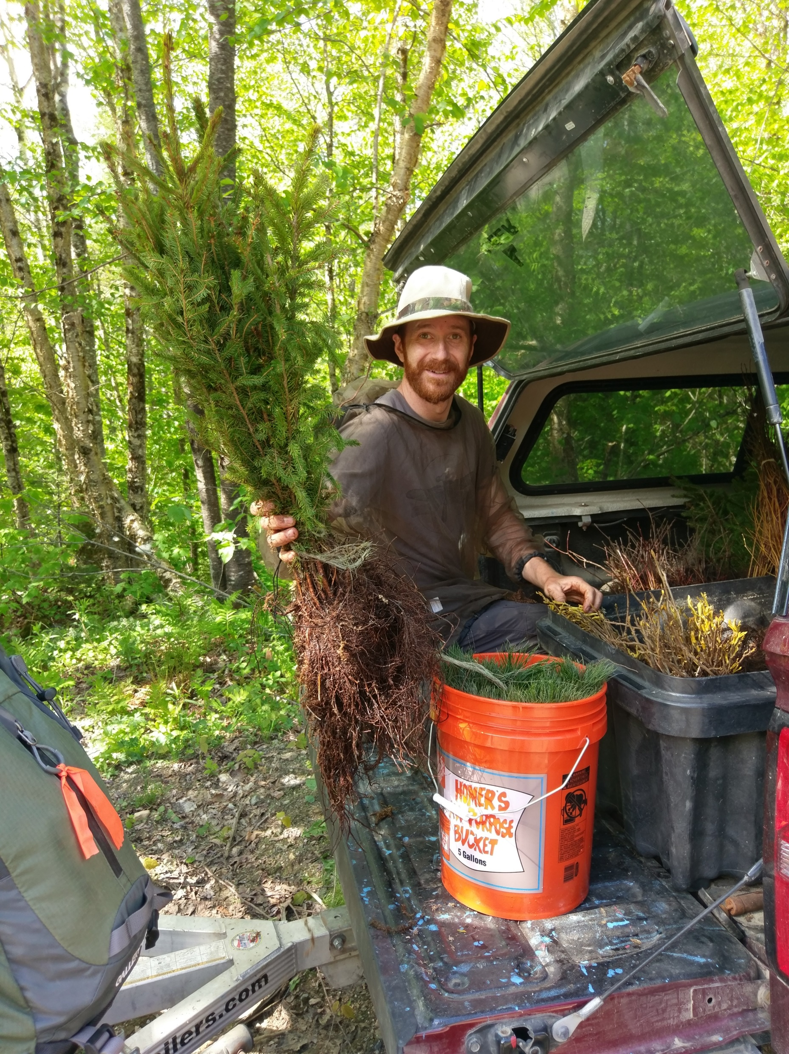
Adaptive management direct seeded (natural dispersal) vs. nursery stock (assisted migration)
Difference (Increase) in Survival of Nursery Stock Versus Direct Seed
Precipitation treatment had no effect on first year survival of planted nursery stock
Nursery stock have higher survival than direct seeding
  But the difference strongly associated with functional traits
Implications for managers considering compositional shifts through assisted migration and transitional silviculture
Notes:
In thinking about adaptive management strategies, here we compare rates of survival from our direct seeded seedlings which would be analogous to naturally dispersed migration versus planted nursery grown stock which is analogous of plantings for assisted migration.
You’ll just have to take this guys word for it that Precipitation treatment had no effect on first year survival of planted nursery stock in this experiment
A we know from 100 years of silvics that mature seedlings survive at higher rates than germinating seeds,
But the difference in the rates of survival between nursery stock and direct seeded species is strongly associated with functional traits, specifically seed mass
We see a significant increase in the rate of survival in small seeded species, such as birch, pine, and hemlock compared to larger seeded species.
There are many implications for this, but for managers considering managing for future adaptability in stand composition, this further emphasizes the importance of functional traits for decision making

Slide 17
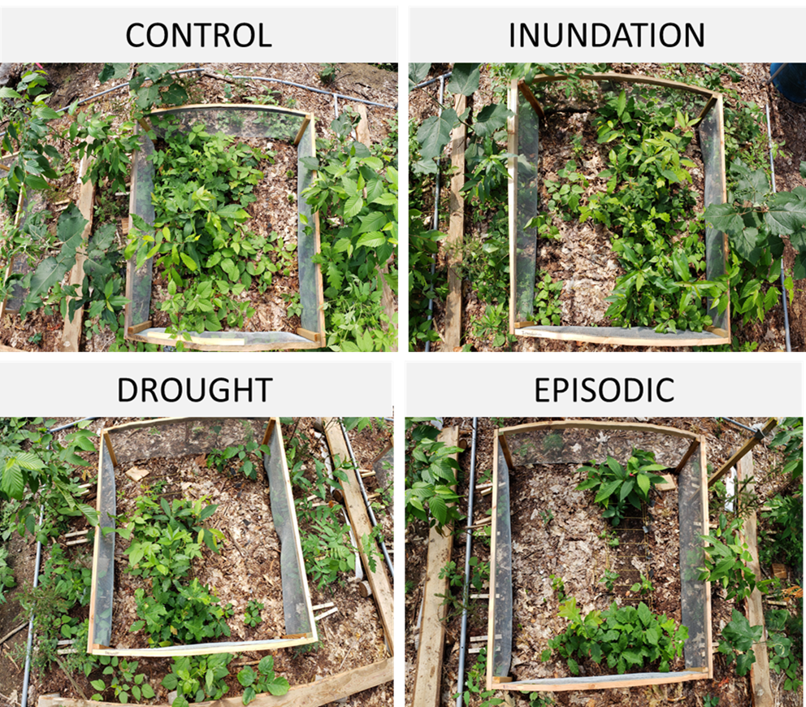
Ancillary Competition may filter regeneration
Competition Response from Ancillary Species
Herbaceous competition cover follow similar trends
Density implications, resource availability, browse…
Will competition * precipitation filter regeneration response?

Slide 18
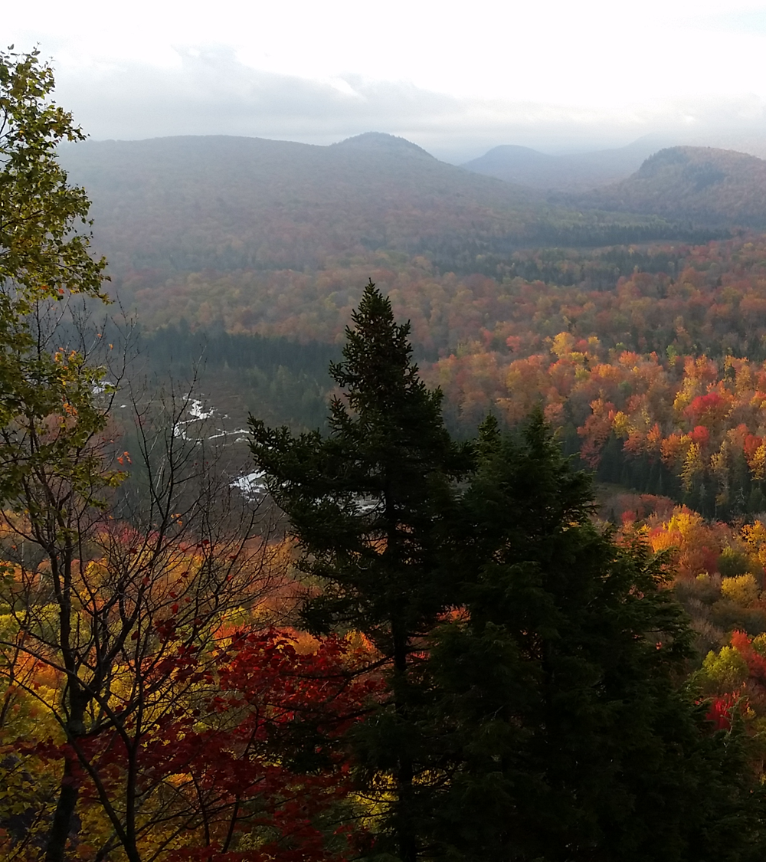
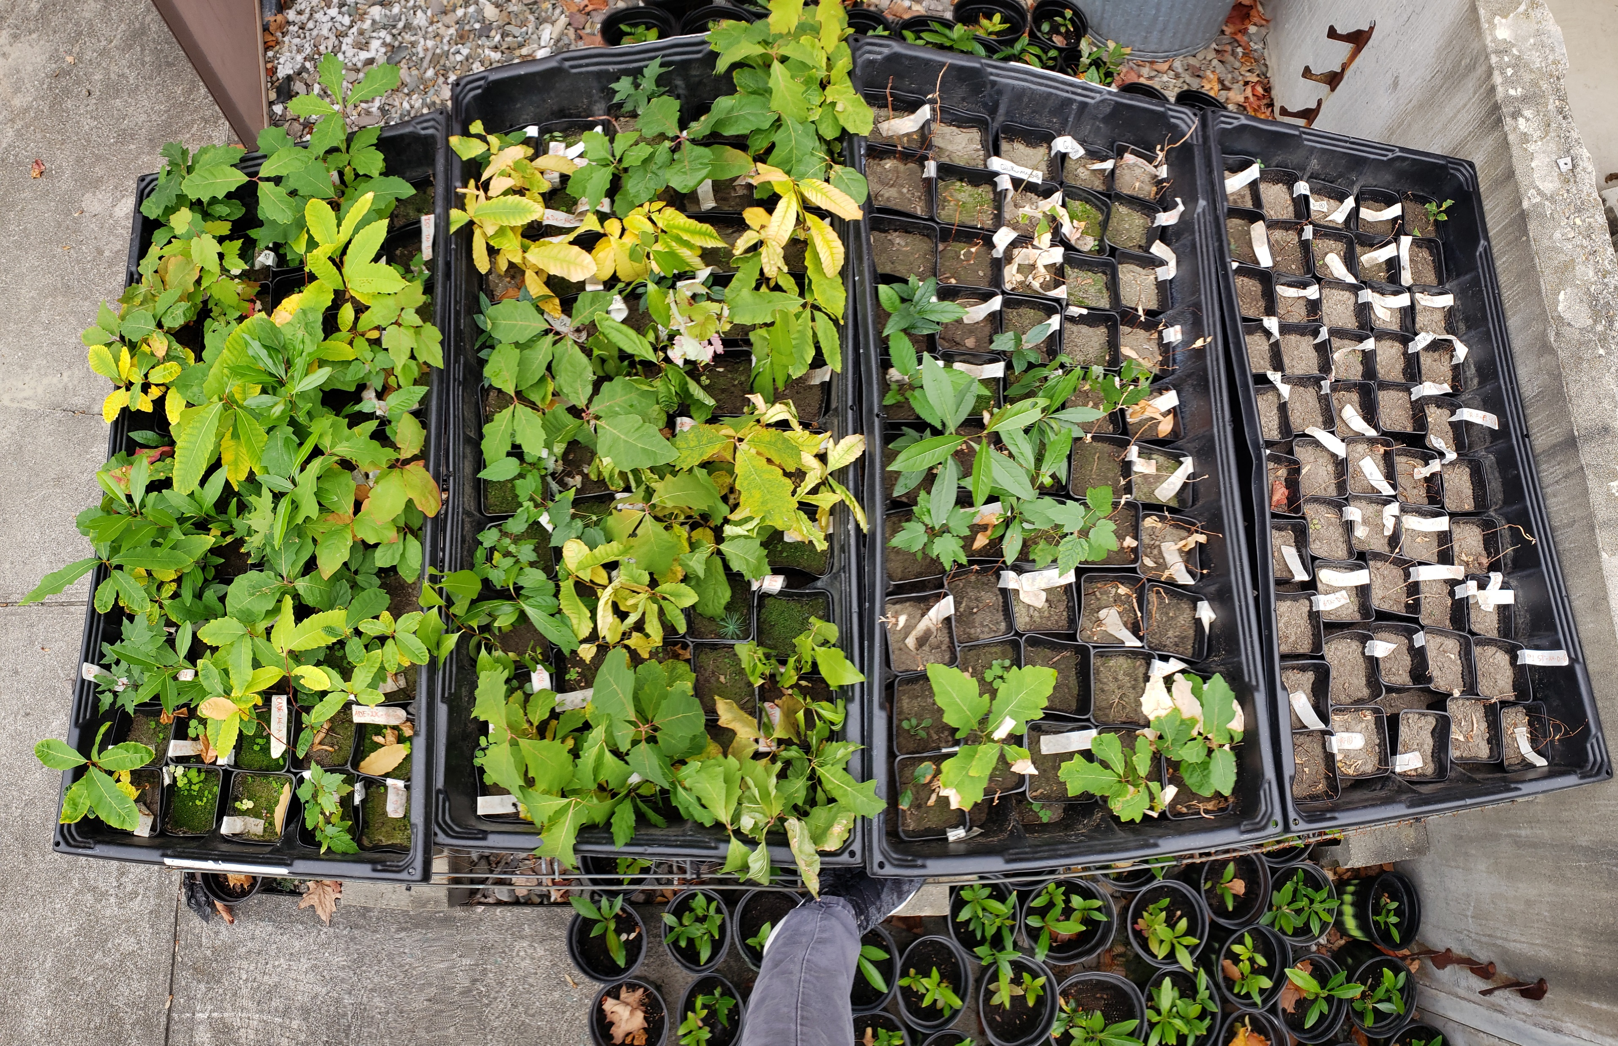
Summary and Considerations
Study captures trends, but variability exists
  Water holding capacity of soils
  Inter- vs intra-species variation (provenance)
  Silvicultural treatments (canopy throughfall)

Slide 19
Summary and Considerations
Study captures trends, but variability exists
  Water holding capacity of soils
  Inter- vs intra-species variation (provenance)
  Silvicultural treatments (canopy throughfall)
Four treatments tested, but two physiological responses
  Precipitation frequency > volume for seedling survival

Slide 20
Summary and Considerations
Study captures trends, but variability exists
  Water holding capacity of soils
  Inter- vs intra-species variation (provenance)
  Silvicultural treatments (canopy throughfall)
Four treatments tested, but two physiological responses
  Precipitation frequency > volume for seedling survival
Functional traits, seed bed, life stage, and [possibly] competition matter
  Implications for future forest composition and management considering transitional silviculture

Slide 21
Summary and Considerations
Study captures trends, but variability exists
  Water holding capacity of soils
  Inter- vs intra-species variation (provenance)
  Silvicultural treatments (canopy throughfall)
Four treatments tested, but two physiological responses
  Precipitation frequency > volume for seedling survival
Functional traits, seed bed, life stage, and [possibly] competition matter
  Implications for future forest composition and management considering transitional silviculture
Climate envelope models don’t account for canopy disturbance, occupancy, seed bed
Refined interpretations to better reflect the constraints on establishment

Slide 22
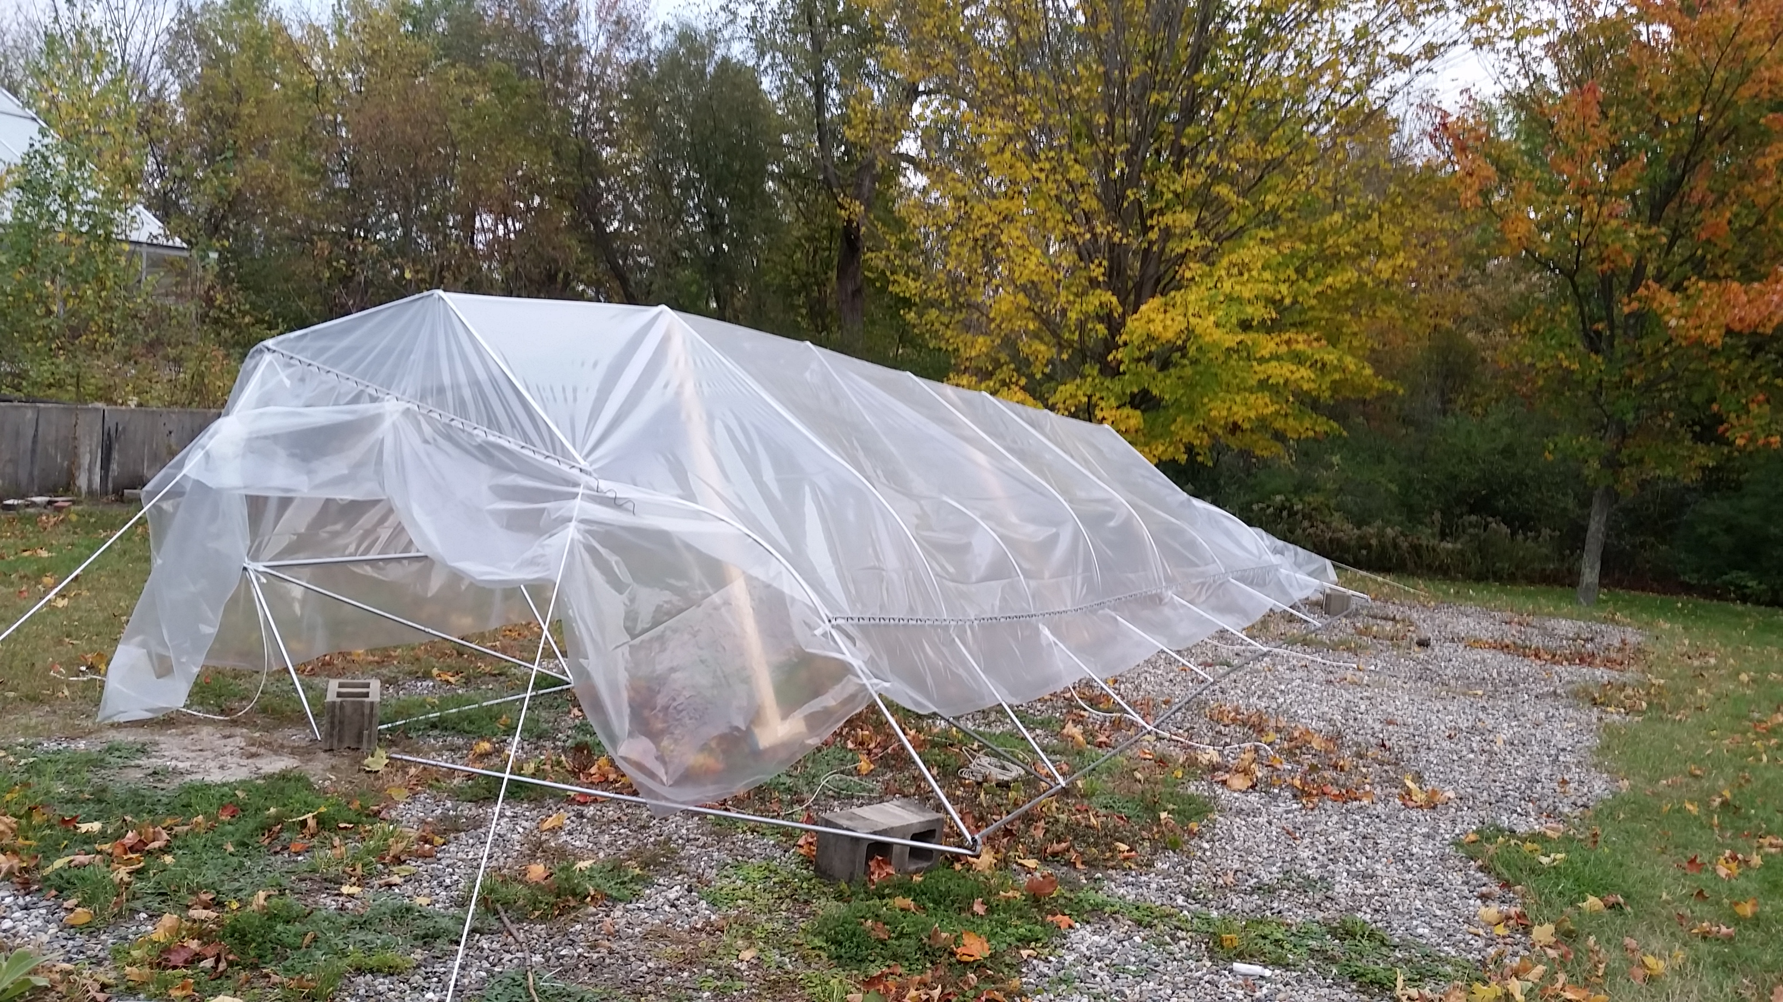



Acknowledgements
Tony D’Amato (UVM)
Paul Schaberg (USFS)
Kendra Collins (ACF)
Shawn Fraver (UME)
Ralph Tursini (UVM)
John Butnor (USFS)
Emma Sass (UMass)
Loic D’Orangeville (UNB)
Jen Santoro (UVM)
Matthias Nevins (UVM)
Jordan Luff (UVM)
Olivia Box (UVM)
Tessa McGann (UVM)
Amelia Tarren (UVM)
Collaborators and Research Support
UVM
UNDERGRADS
Deni Ranguelova
Jack Goldman
Suki Wilder
Marcos Kubow
Josh Lagerquist
Rebecca O’Dowd
Tom Casper
Brian Kurmin
Sophie Marinace

